Slide 1
EDES 301 Portable Drum Machine Proposal
02/22/2026
Alejandro Andrade

Slide 2
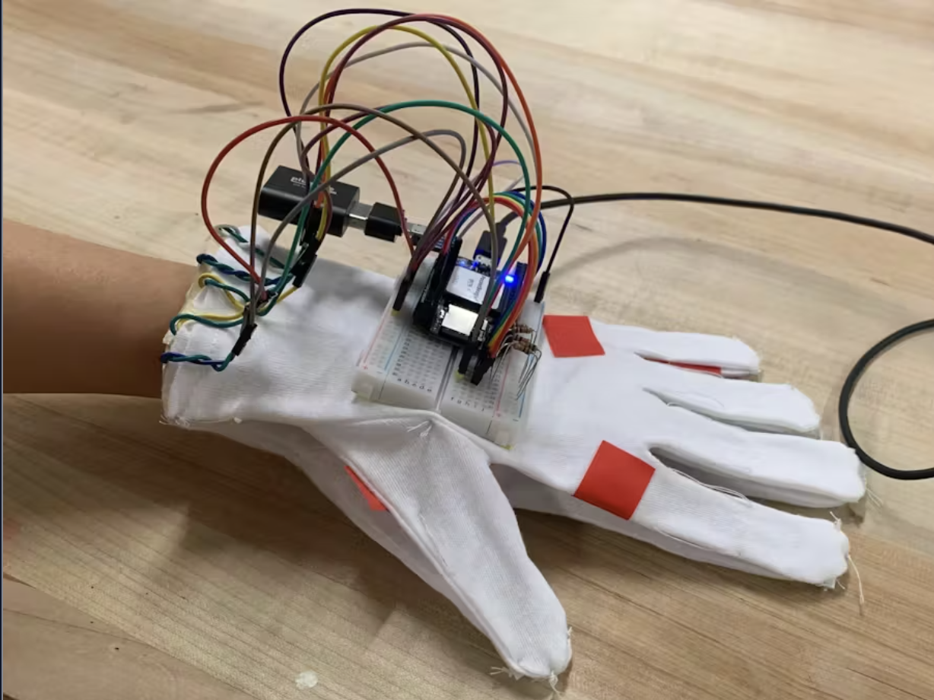
Background Information
What is being proposed?
A portable drum machine with an audio jack for headphones and a metronome, activated by touch sensors. Another important factor is that I want memory storage so that you can save and call back drum patterns and play them so you can use them later. The purpose of this mini drum machine is that you can take it with you anywhere and then come back home with pattern ideas, and use your real drum machine to produce music.
Pictures
Links to existing projects / libraries
https://www.hackster.io/jas21/pocketbeagle-synthesizer-10f638
https://www.hackster.io/eric-voigt/instrument-glove-4537b7
What improvements / additions over existing project
Metronome
Memory
Perhaps several instruments?
Volume Control
Scrolling

Slide 3
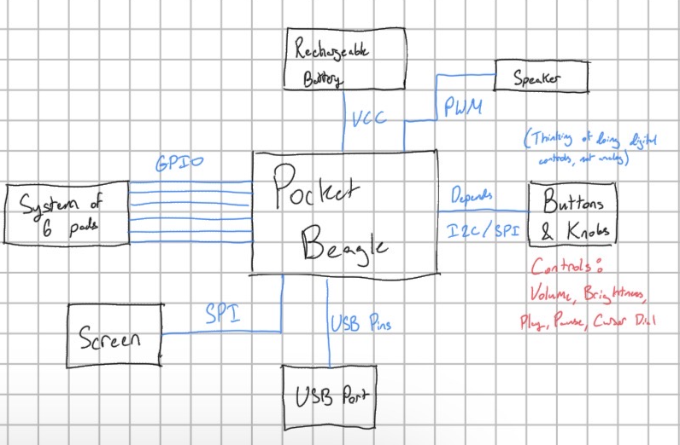
System Block Diagram

Slide 4
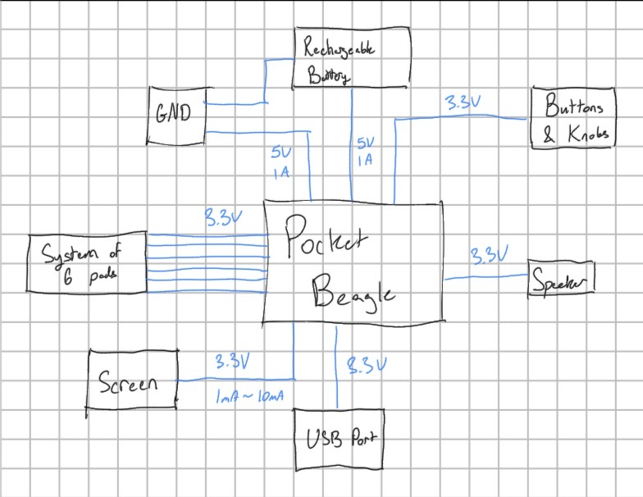
Power Block Diagram

Slide 5
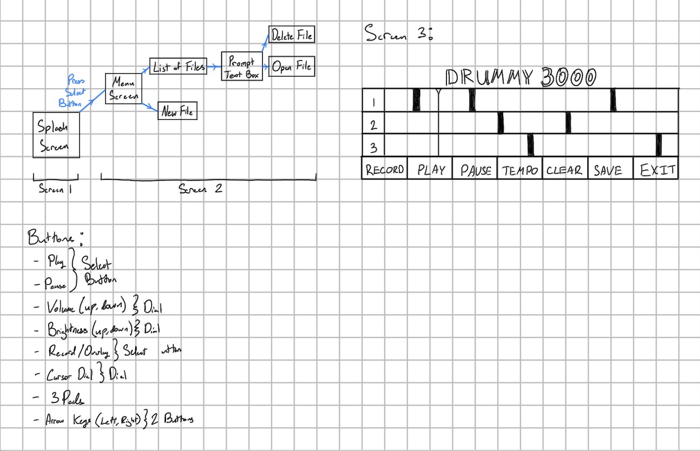
Power Block Diagram

Slide 6
Components / Budget
Component | EDES301 to Buy? | Cost
Screen (2.42 oled display module) | Yes | 11.48
USB to Audio Jack | Yes | 0.92
Capacitive Touch Pads | Yes | 8.39
USB Port | No | -
Dials | No | -
Buttons | No | -
USB Speaker | No | -
Rechargeable Battery (Adjust to USB Battery Pack or something) | Yes | 7.78
See Next Slide for Instructions

